Slide 1


Multi-Frequency Resonator Development for Studying Volume-Limited Metallo-Proteins
Jason W. Sidabras
D. Suter, E.J. Reijerse, W. Lubitz

Slide 2
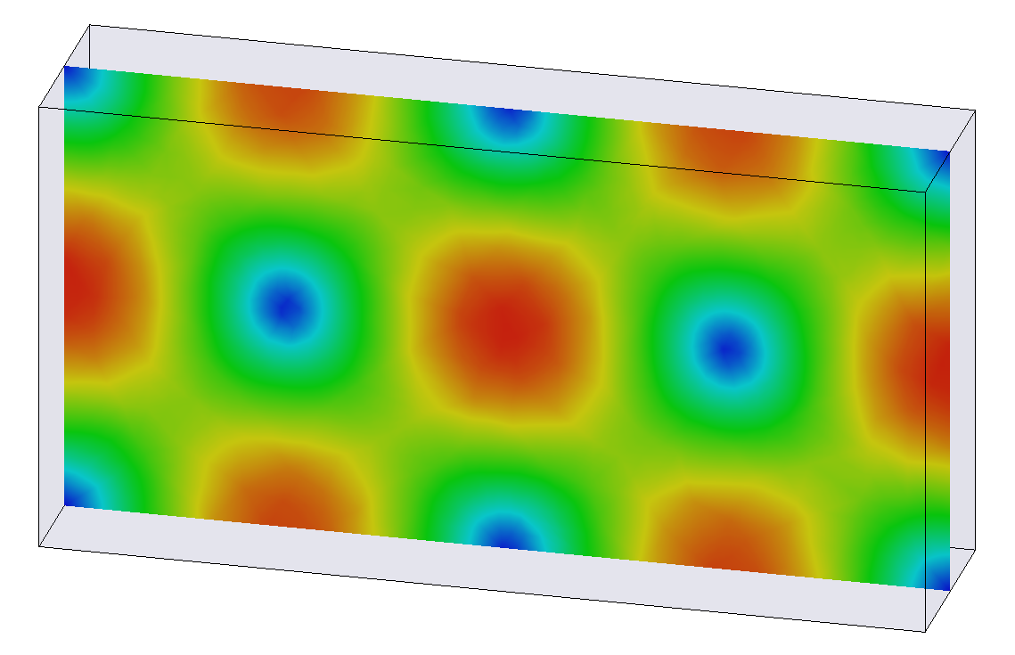
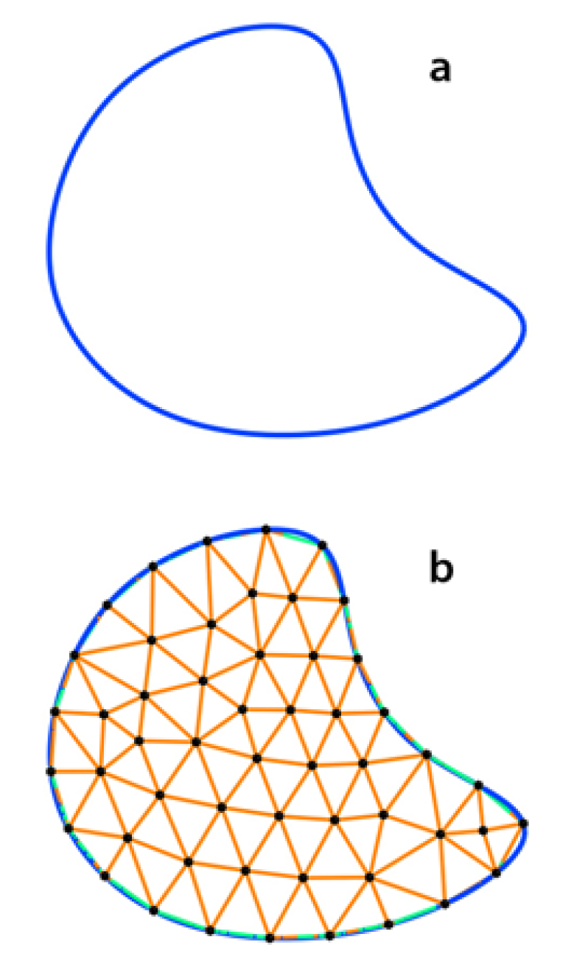
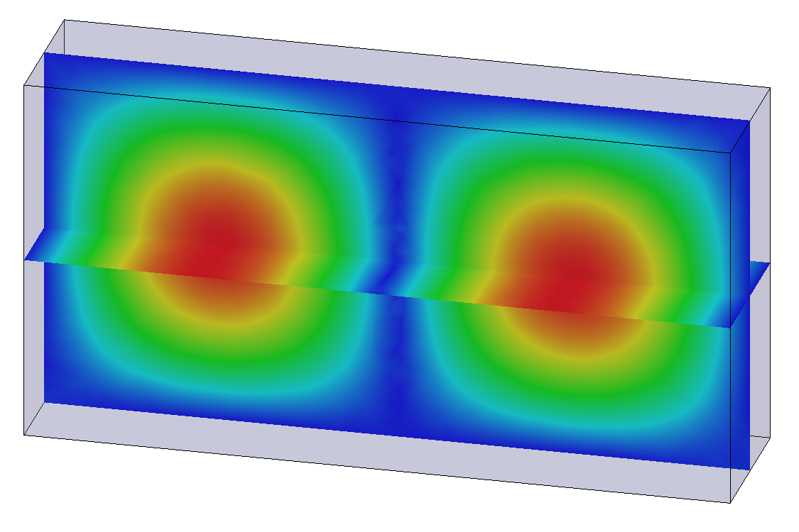
Resonator Introduction
Rectangular TE₁₀₂
Finite-Element Modeling
Ansys HFSS solves the full-wave Maxwell’s Equations for a given geometry and boundary condition
Build and Test on the Bench
Characterize the resonators and compare to simulation
Measure coupling, frequency, and Q-value
Experiments with Standard Samples
Further characterize the resonators using EPR
Sample handling
Magnetic field magnitude
Electric field magnitude
Notes:
----- Meeting Notes (3/30/17 16:58) -----
title methods

Slide 3
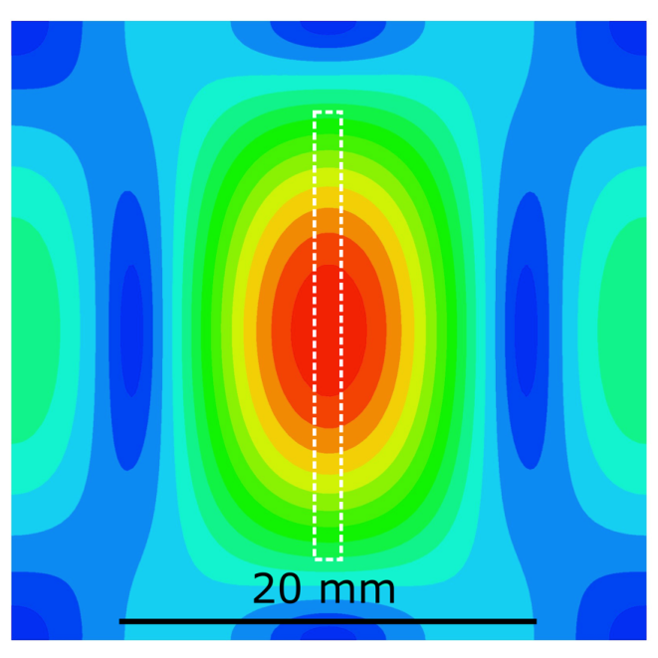
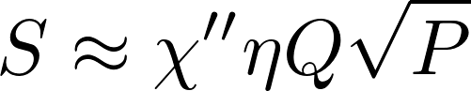
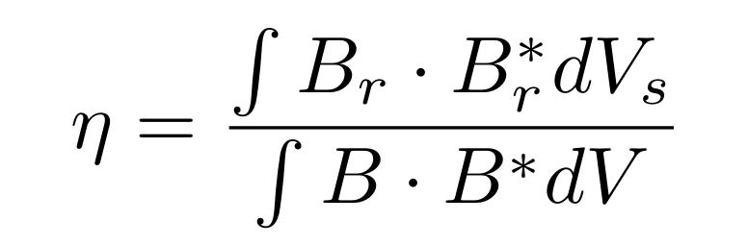
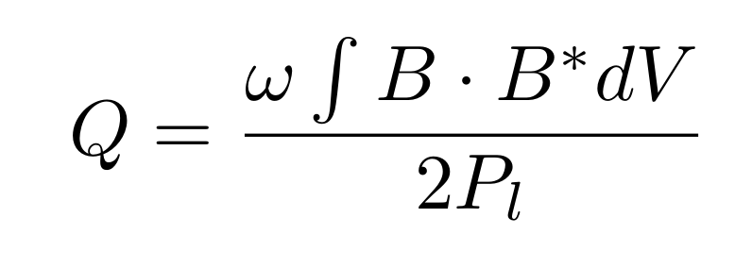
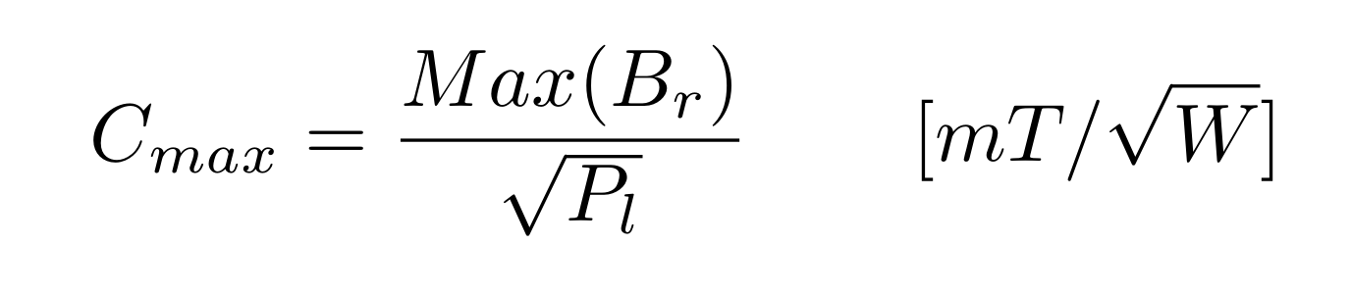
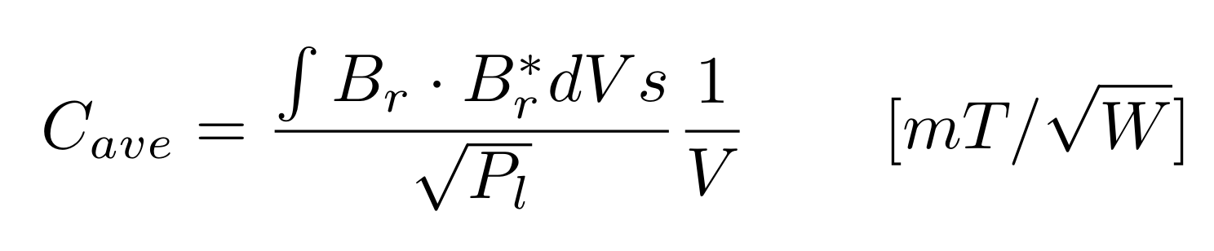
Resonator Characteristics
Based on a critically coupled resonator and reflection bridge configuration
Signal:
Cylindrical TE₀₁₁
Filling Factor
Q-value
Conversion Factor:
Feher, Sensitivity Considerations in Microwave Paramagnetic Resonance Absorption Techniques, 36(2). 449,1957
Hyde, Froncisz, Advanced EPR: Applications in Biology and Biochemistry, Elsevier, 1989, Ch. 7: Loop-gap resonators, 277
Notes:
----- Meeting Notes (9/8/16 15:18) -----
finite-element modeling gives me these solutions
----- Meeting Notes (3/30/17 16:58) -----
mention TE011
square root sign
cavity resonators

Slide 4
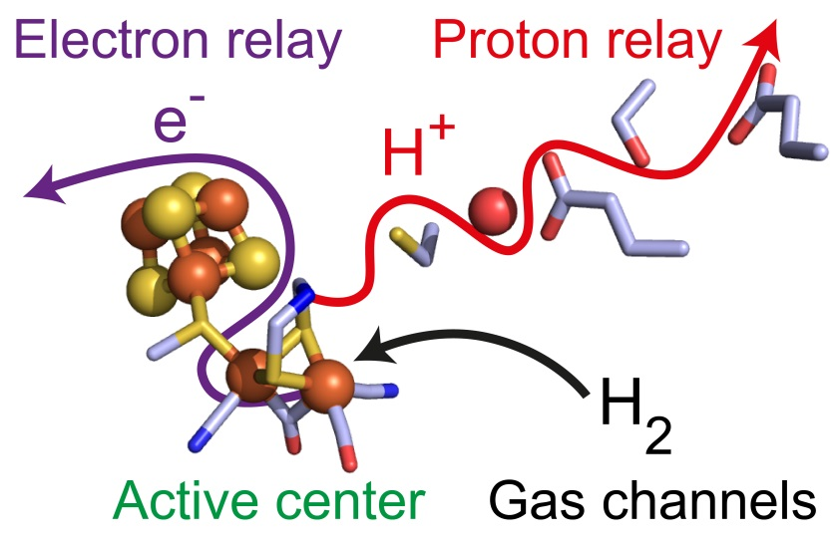
Motivation
Extremely Sample Limited
Resonator design for Nano-liter volumes at X-band
Materials Research
Samples of Limited Availability
Systems on a Chip/Micro-fluidics
Protein Single Crystals
Hydrogenase
2H⁺ + 2e⁻ ⇌ H₂
Understanding the mechanism of biological hydrogen conversion

Slide 5
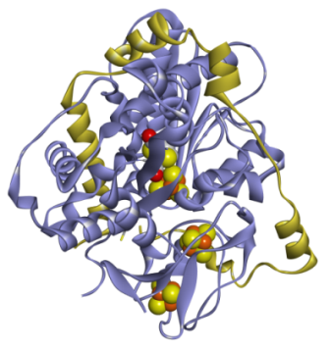
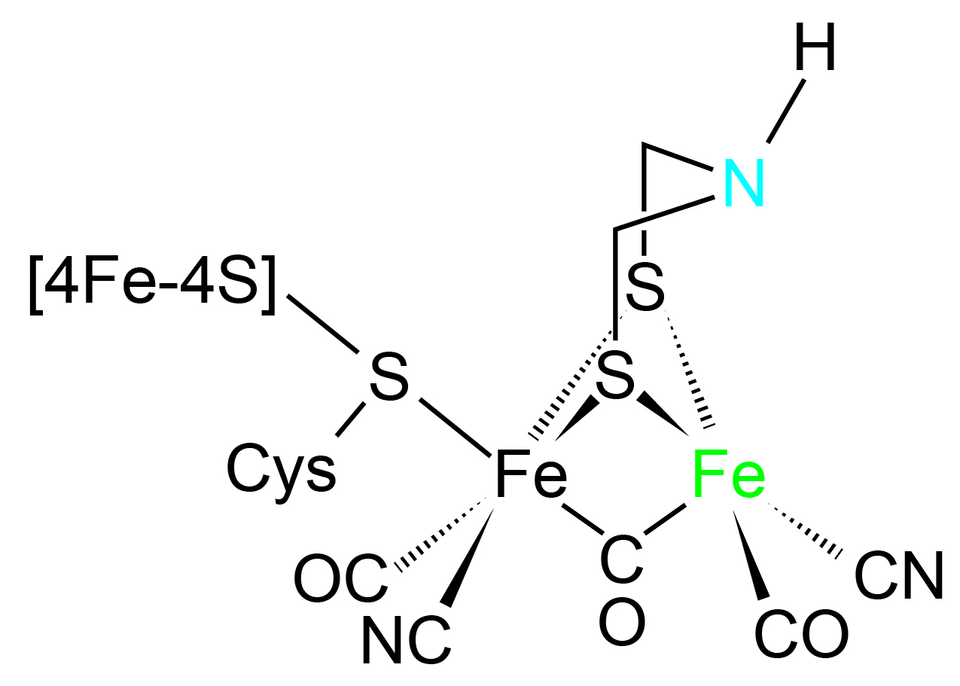
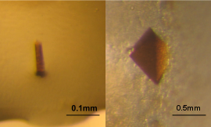
Single Protein Crystal [FeFe] Hydrogenase
D. desulfuricans HydAB
To date no single crystal studies have been performed on [FeFe] Hydrogenase
Using FTIR, EPR, NMR, Raman, and NRVS a convincing catalytic cycle has been hypothesized.
However, it is very difficult to hypothesize the F-clusters and g-tensors axis, protein single crystals are needed.
0.5-50 nanoliter
Lubitz, Ogata, Rüdiger, Reijerse, Hydrogenases, Chem. Rev., 114, 2014
Notes:
----- Meeting Notes (3/30/17 16:58) -----
7-10 A

Slide 6
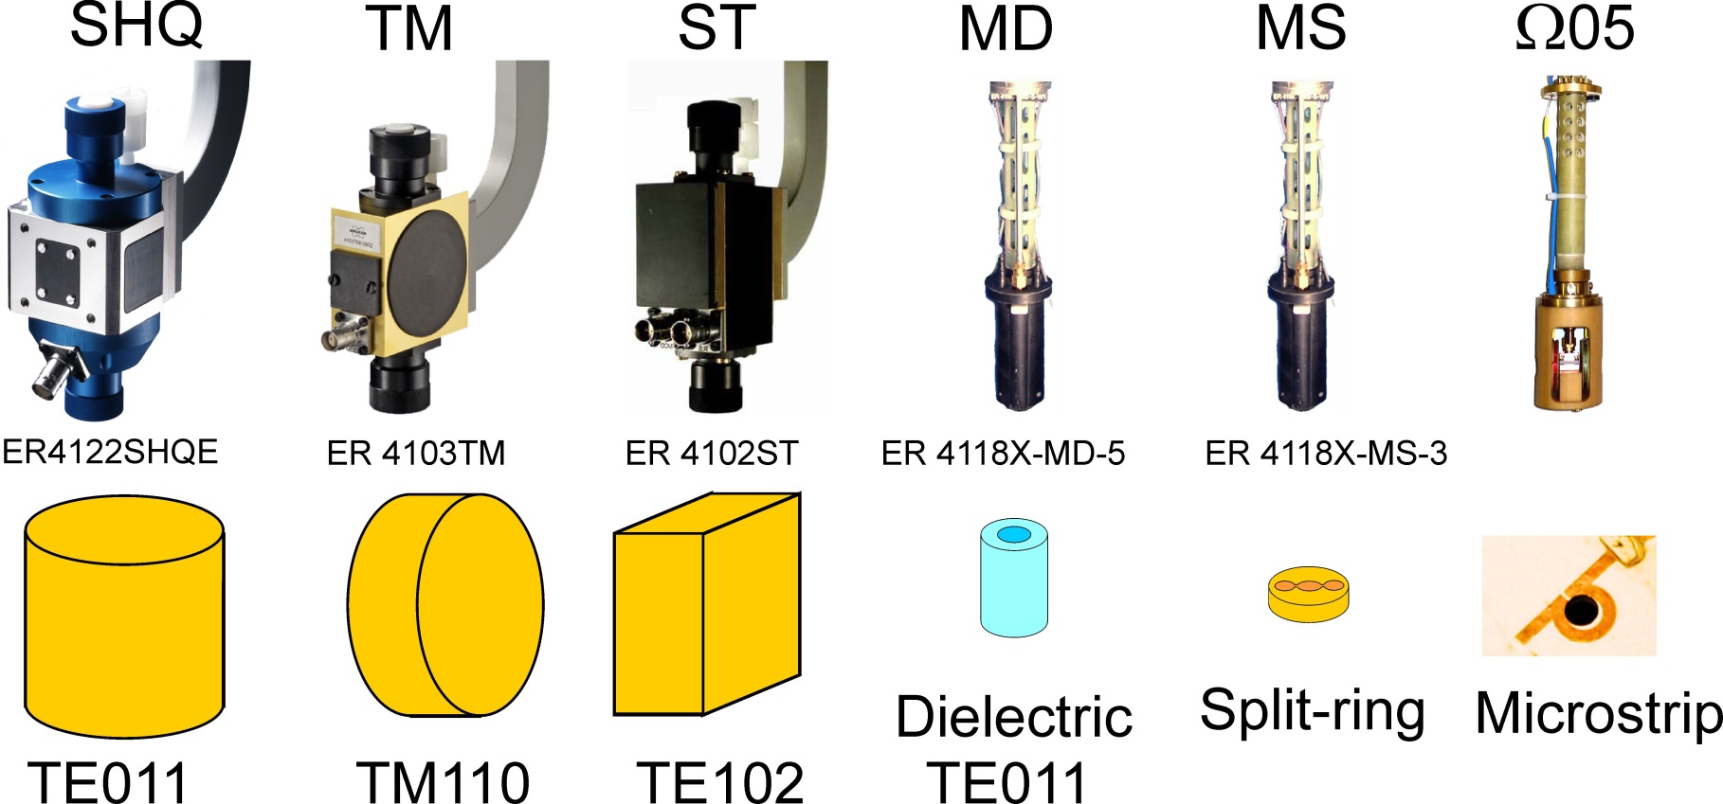
Increasing Sensitivity for Limited Samples

Slide 7
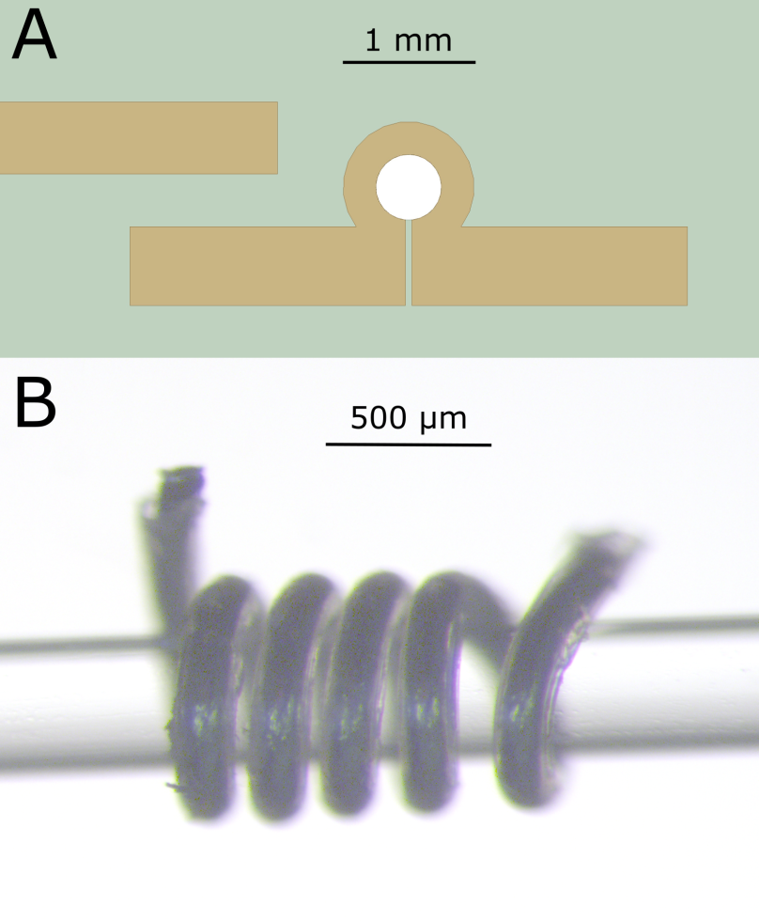
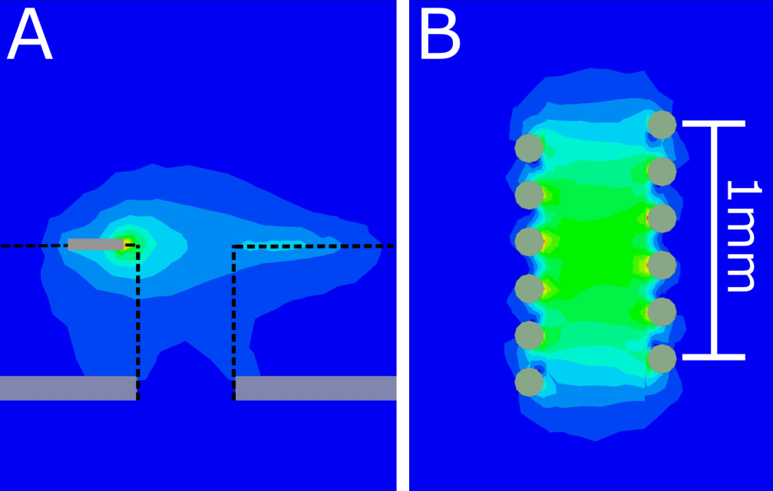
Planar Micro-Resonators at X-band
Resonator fabricated using standard lithography techniques
Loop of 0.5 mm diameter or smaller
Resonance is achieved using strip-line impedance
Sapphire substrate has a Q-value of 180 with a high filling factor
A factor of 2 is realized over the Bruker MD5 dielectric resonator for a sample size of 0.3 x 0.2 x 0.2 mm³
Narkowicz, Suter, Stonies, J. Magn. Reson., 175, 2005

Slide 8
Micro-Helix at X-band
Higher concentration of B₁
Higher Q-value of 360 due to surface vs. volume currents
More homogeneous field
Easier placement of small samples
1.2 mm Tall
5 windings 9.7 GHz
0.15 mm silver wire
0.4 mm inner diameter

Slide 9
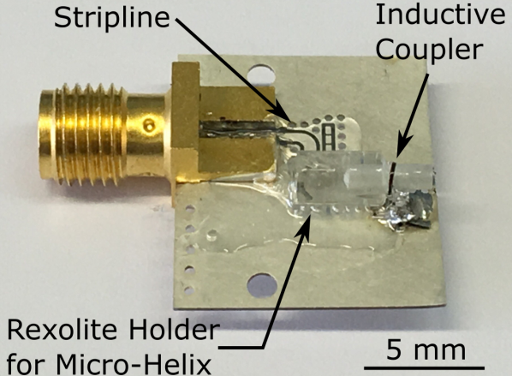
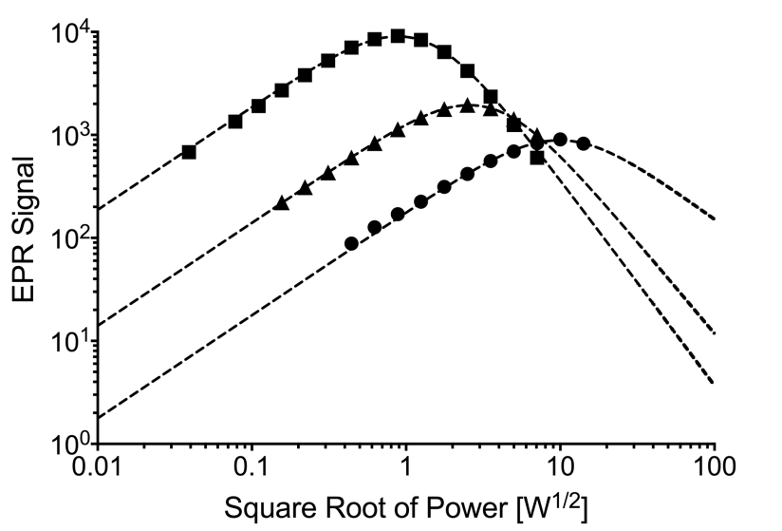
Micro-Helix Preliminary Results
Simulated
Simulation | DR ε=10 | PMR 0.5 mm | Helix 0.4 mm
Freq. [GHz] | 9.67 | 9.58 | 9.41
Q₀-value | 15000 | 186 | 360
Norm. Ss | 1 | 2.09 | 9.5
C_{max} [mT/W^{1/2}] | 0.65 | 3.7 | 3.5
C_{ave} [mT/W^{1/2}] | 0.65 | 2.2 | 3.3
Measured
LiPC Crystal 0.3 x 0.2 x 0.2 mm³
Norm. Signal Saturable
MD5: 1
PMR: 2.2
Micro-Helix: 10.2
Sidabras, Reijerse, Suter, Lubitz, In Preparation
Notes:
Add slide numbers
----- Meeting Notes (9/8/16 15:29) -----
LiF SHow which is which
----- Meeting Notes (3/30/17 16:58) -----
micro helix advantages
scale on

Slide 10
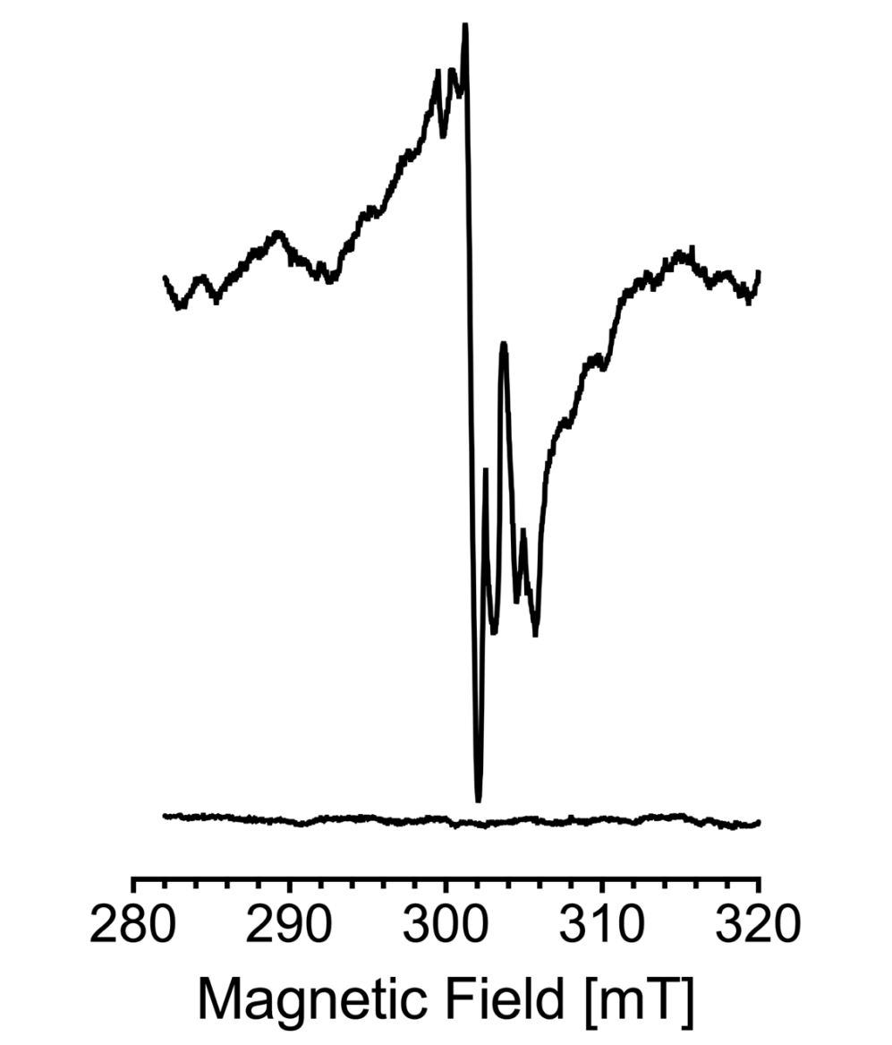
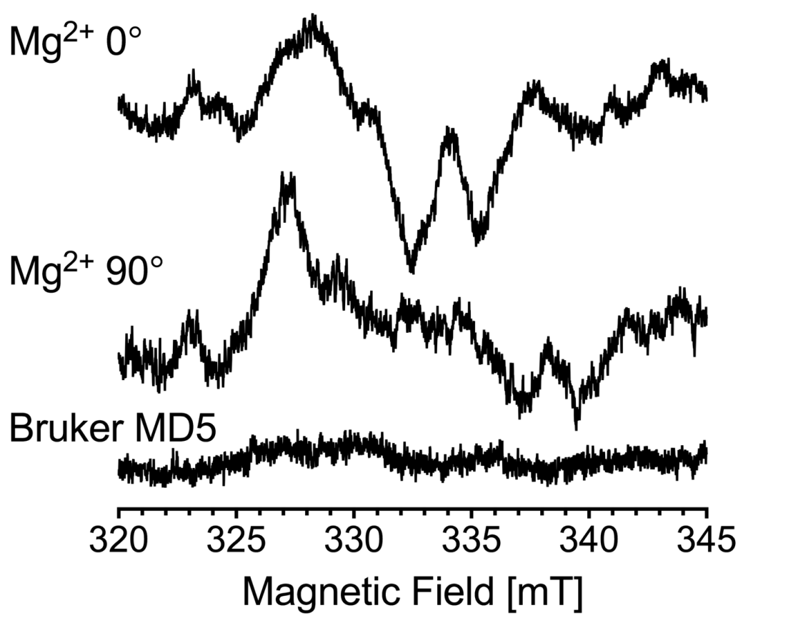
Micro-Helix Preliminary Results
Experimental Results:
Tyrosine (Y_{D}*) Radical in Photosystem II
Experiment performed at 120 K.
0.3 x 10¹² spins/G
Single Crystal
0.3 x 0.3 x 0.25 mm³
Experimental Results:
Mn²⁺ signal
Empty Resonator
Sidabras, Reijerse, Suter, Lubitz, In Preparation
Notes:
----- Meeting Notes (3/30/17 16:58) -----
measurements doing on a crystal
0.3 x 0.3 x 0.5

Slide 11
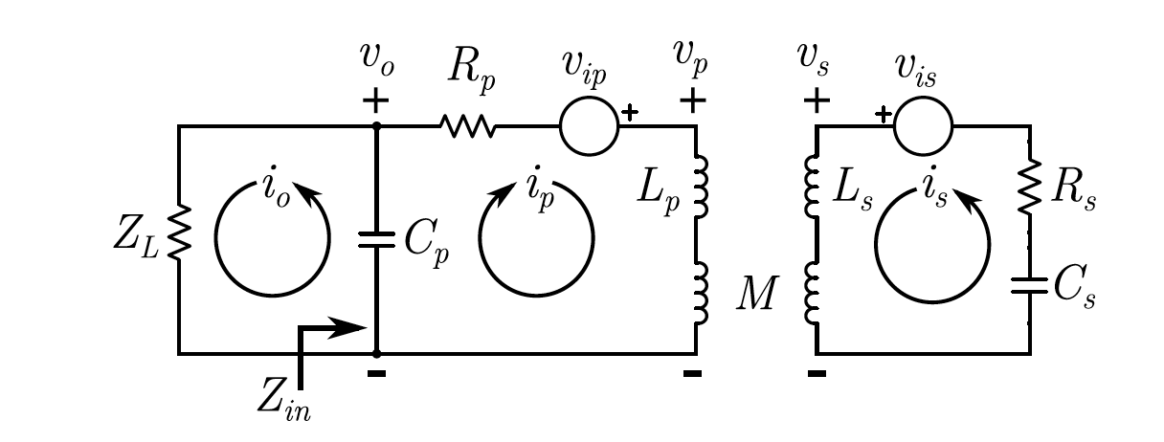
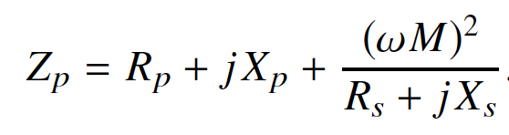
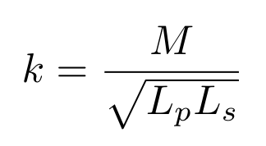
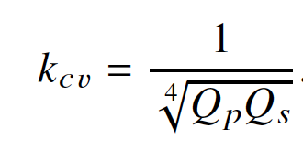
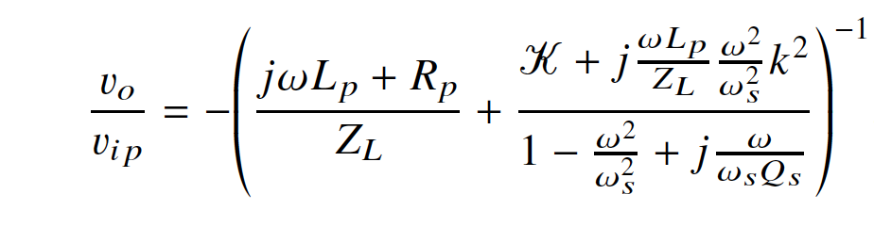
Coupling with Large Mutual Inductance
Coupling constant k is much larger than needed for maximum power transfer.
Instead the coupling constant is optimized for maximum impedance transfer.
The primary is then matched to the load for typical power transfer.
Output voltage is enhanced and noise is reduced.
Sidabras, Mett, Hyde, MRI surface-coil pair with strong inductive coupling, Rev. Sci. Instrum., 87, 124704, 2016

Slide 12
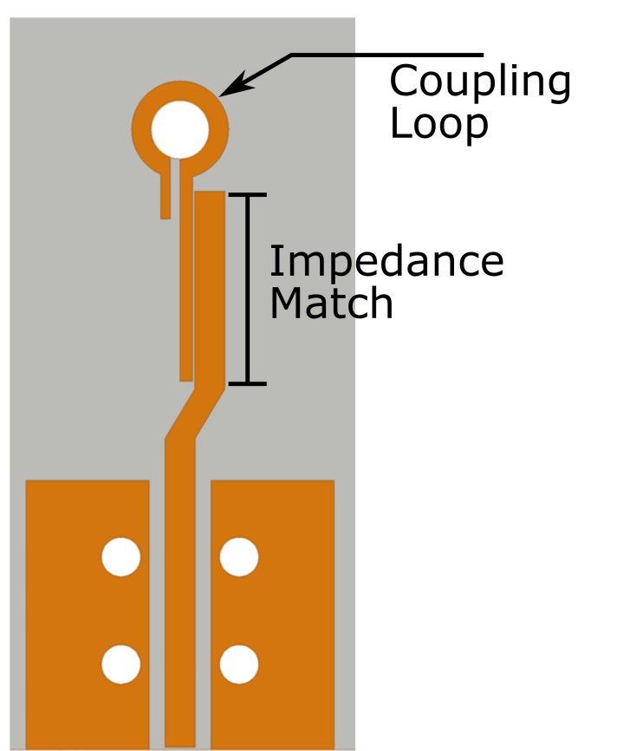
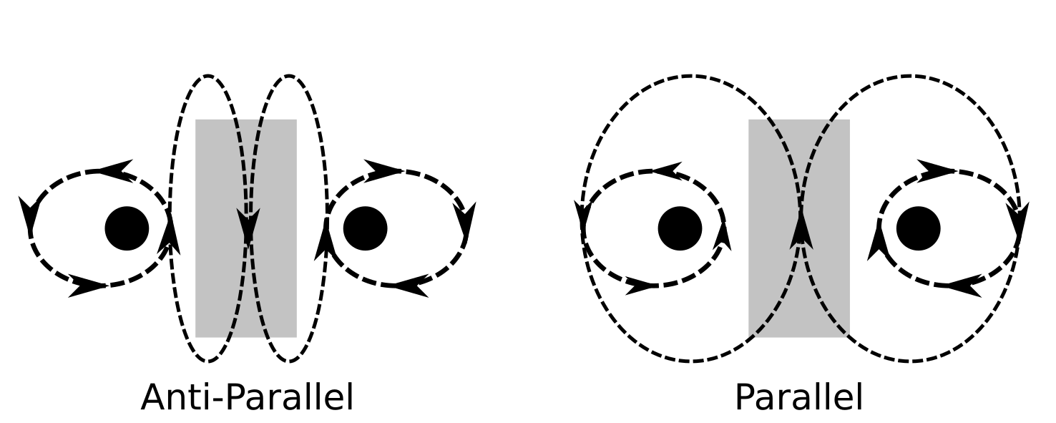
Coupling with Large Mutual Inductance
~1.7x coupling enhancement
(17x total over MD5)
Current Coupling Scheme:
Grounded loop has a very high self-resonance (~30 GHz)
Currently coupling the anti-parallel mode
Significant capacitance lowers modes and mutual inductance
Parallel mode is measured at ~2 GHz
New Coupling PC Board:
Loop Resonant at 17 GHz
Planar loop reduces E-field
Coupling implemented

Slide 13
Very High Frequency Applications

Slide 14
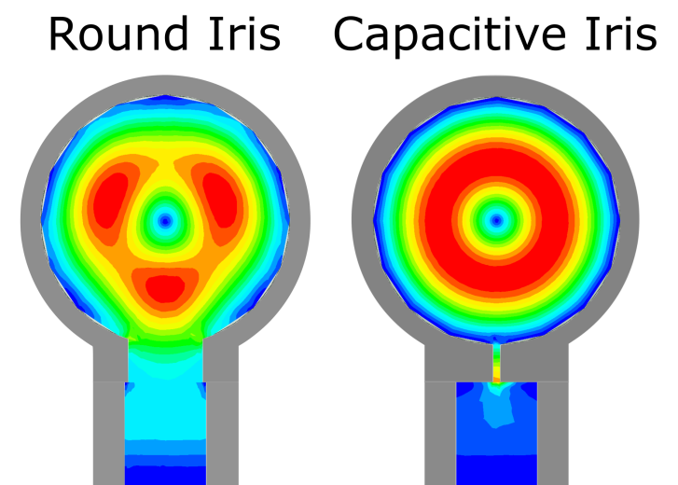
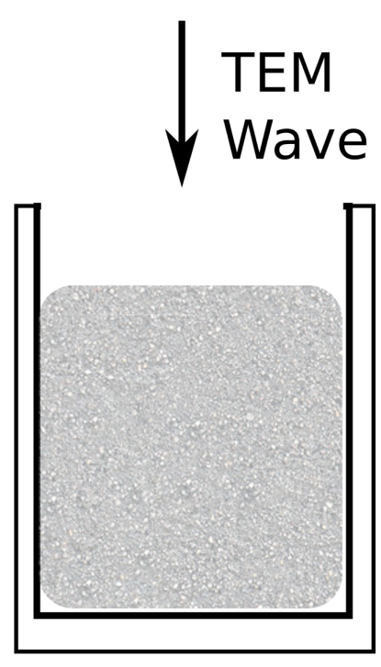
244 GHz Single-Mode Resonators
Bucket Resonator is simplest structure
Sacrifices Q-value and B₁ distribution for sample volume.
A TE₀₁₁ mode improves by least a factor of 2
TE₃₁₁ has z-component of electric field. This leads to significant microwave leakage through modulation slots.
71.2% 1.7%
40%
2.5%

Slide 15
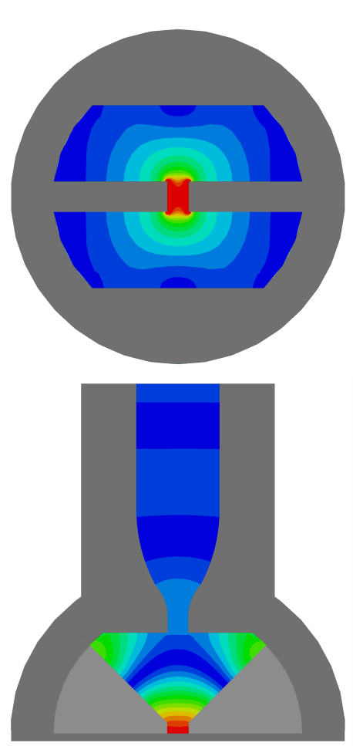
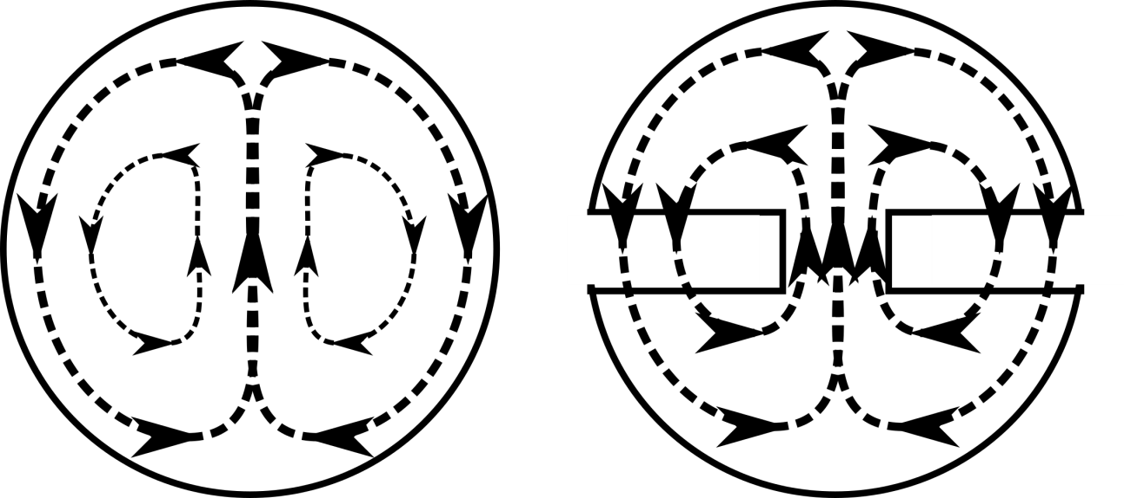
244 GHz Re-Entrant Semi-Spherical TE₀₁₁
Geometry | Cylindrical TE₀₁₁ D/L=1 | Re-Entrant Semi-Spherical TE₀₁₁
Frequency | 240.5 | 243.6
Q₀-value | 4300 | 1200
Signal, S_{u} | 0.96 | 2.15
Signal, S_{s} | 0.04 | 0.06
C_{max} [mT/W^{1/2}] | 3.4 | 3.8
B₀
0.4 mm
B₀

Slide 16
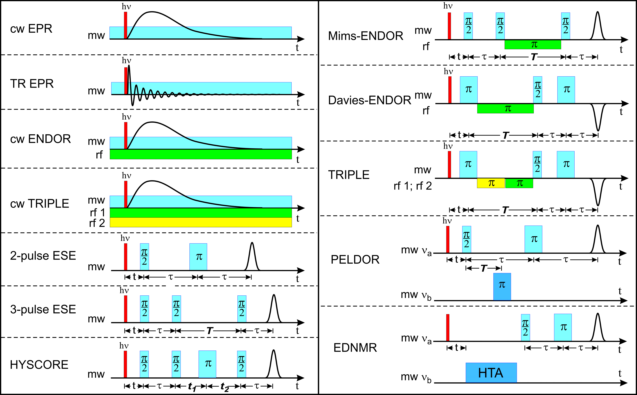
Motivation

Slide 17
Uniform Field Resonators
Design resonator with a region-of-interest at cut-off
Cut-off waveguide has a wavelength of infinity (uniform)
An end-section is needed to properly match the cut-off region
By transferring a short to an open (1/4 wavelength) you can properly match an infinite wavelength.
Mett, Froncisz, Hyde, Rev. Sci. Instrum, 72(11), 2001
Anderson, Mett, Hyde, Rev. Sci. Instrum., 73(8), 2002
Hyde, Mett, Anderson, Rev. Sci. Instrum. 73(11) 2002
Mett, Sidabras, Hyde, Appl. Magn. Reson., 31, 2007
Sidabras, Reijerse, Lubitz, Appl. Magn. Reson. In Press

Slide 18
Uniform Field Resonators at W-band
Sidabras, Mett, Sarna, Hyde, J. Magn. Reson., 282, 2017

Slide 19
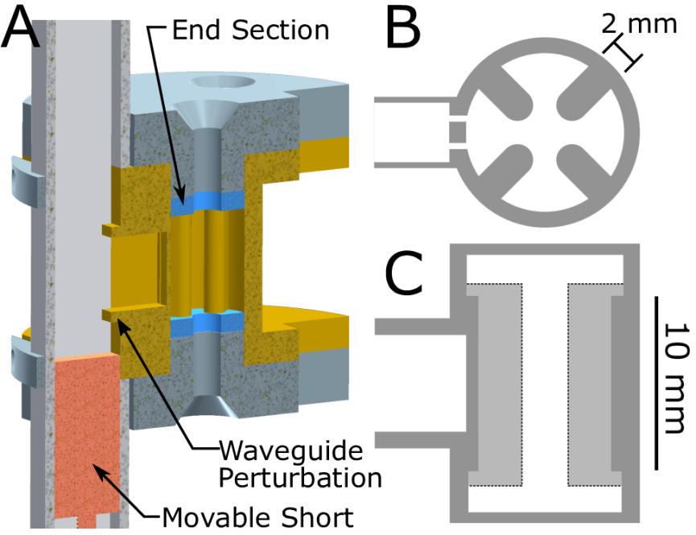
Re-Entrant Uniform Field TE_{01U} at Q-band
Higher concentration of B₁
Lower Q-value for the same EPR signal
Significantly more homogeneous field
Geometry | Cylindrical TE₀₁₁ D/L=1 | UF TE_{01U} | UF TE_{01U} Re-Entrant
Frequency | 34.3 | 34.5 | 34.0
Q₀-value | 13000 | 5900 | 1880
Signal, S_{u} | 1 | 0.73 | 1.06
Signal, S_{s} | 1 | 0.83 | 1.18
C_{max} [mT/W^{1/2}] | 1.06 | 0.65 | 0.94
C_{ave} [mT/W^{1/2}] | 0.52 | 0.52 | 0.83
% Diff | 50.9 | 20 | 11.7
Sample Geo. | 1.8 ID x 2.8 OD | 1.8 ID x 2.8 OD | 1.8 ID x 2.8 OD
Sidabras, Reijerse, Lubitz, Appl. Magn. Reson., In Press, 2017

Slide 20
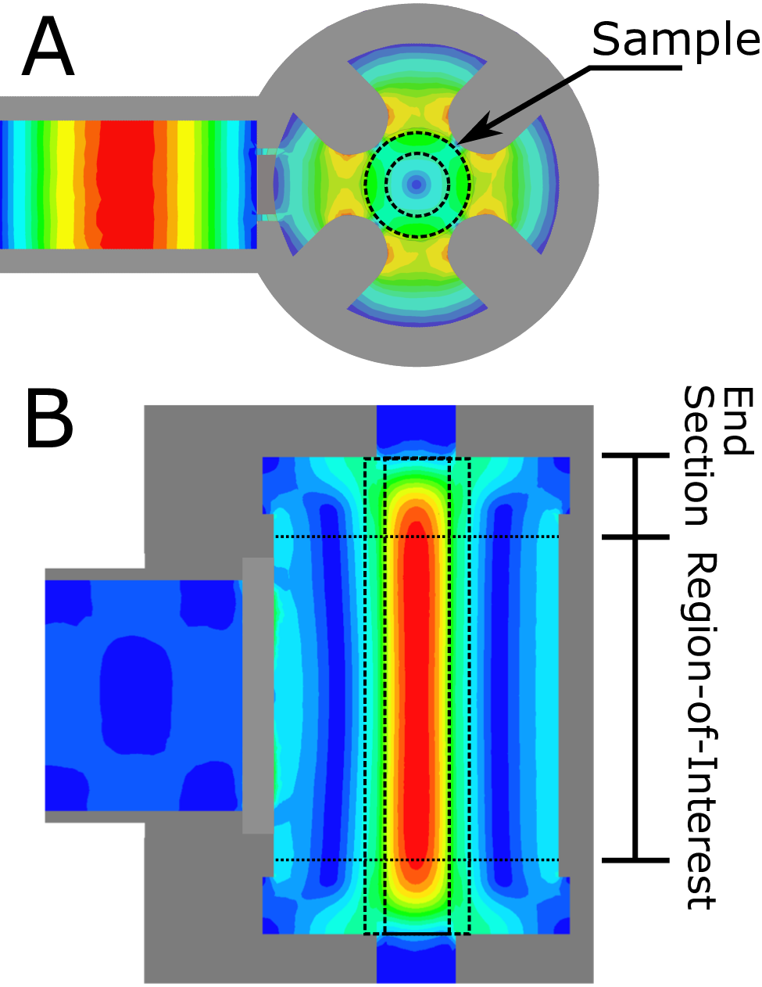
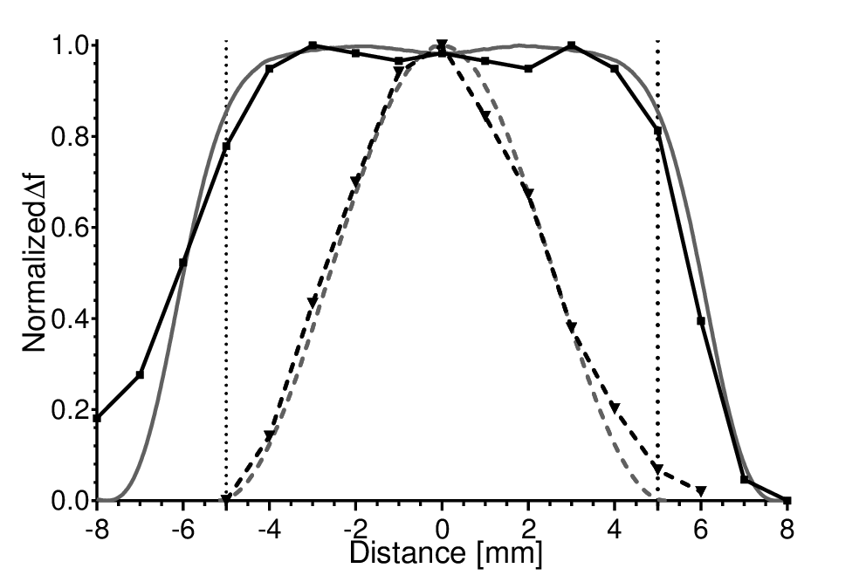
Re-Entrant Uniform Field TE_{01U} at Q-band
Sidabras, Reijerse, Lubitz, Appl. Magn. Reson., In Press, 2017

Slide 21
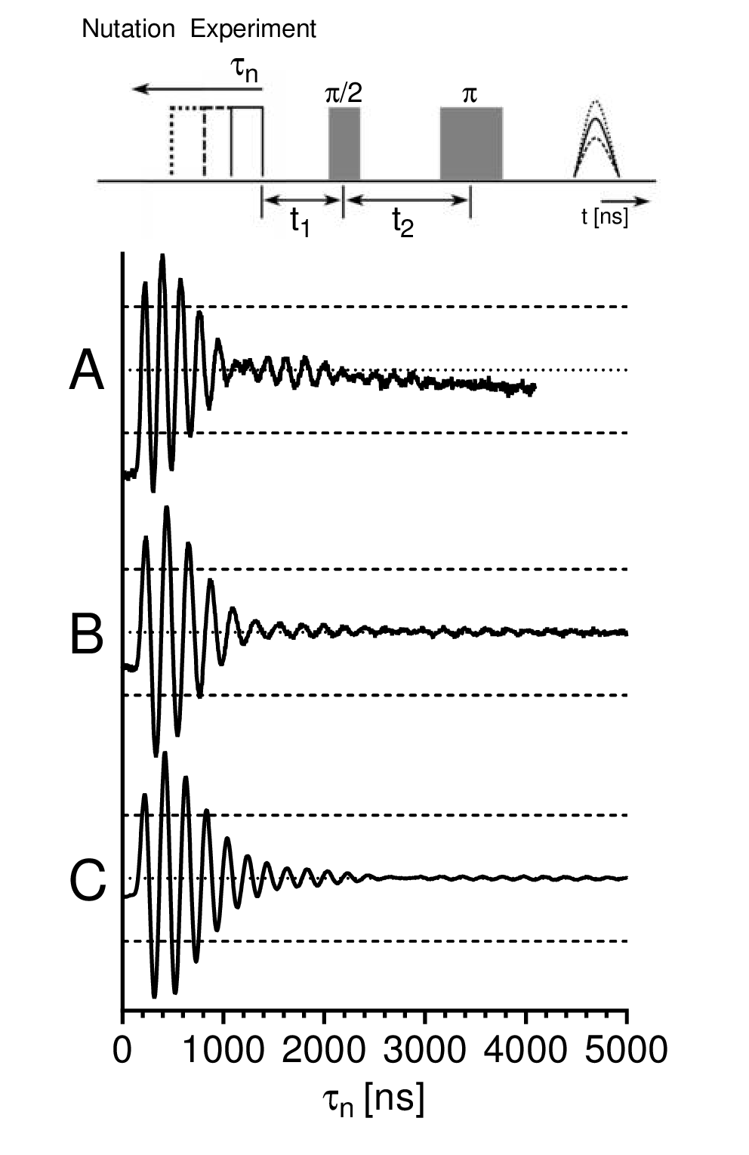
Re-Entrant Uniform Field TE_{01U} at Q-band
Sidabras, Reijerse, Lubitz, Appl. Magn. Reson., In Press, 2017

Slide 22
Re-Entrant TE_{01U} as a General Purpose Cavity
Cylindrical TE_{01U}
Re-Entrant TE_{01U}
Frequency Shift
1.3 GHz
Frequency Shift
0.81 GHz

Slide 23
Re-Entrant TE_{01U} as a General Purpose Cavity
Cylindrical TE_{01U}
Re-Entrant TE_{01U}
Frequency Shift
1.3 GHz
Quartz Capillary
2.8 OD X 0.255 ID
Water Sample

Slide 24
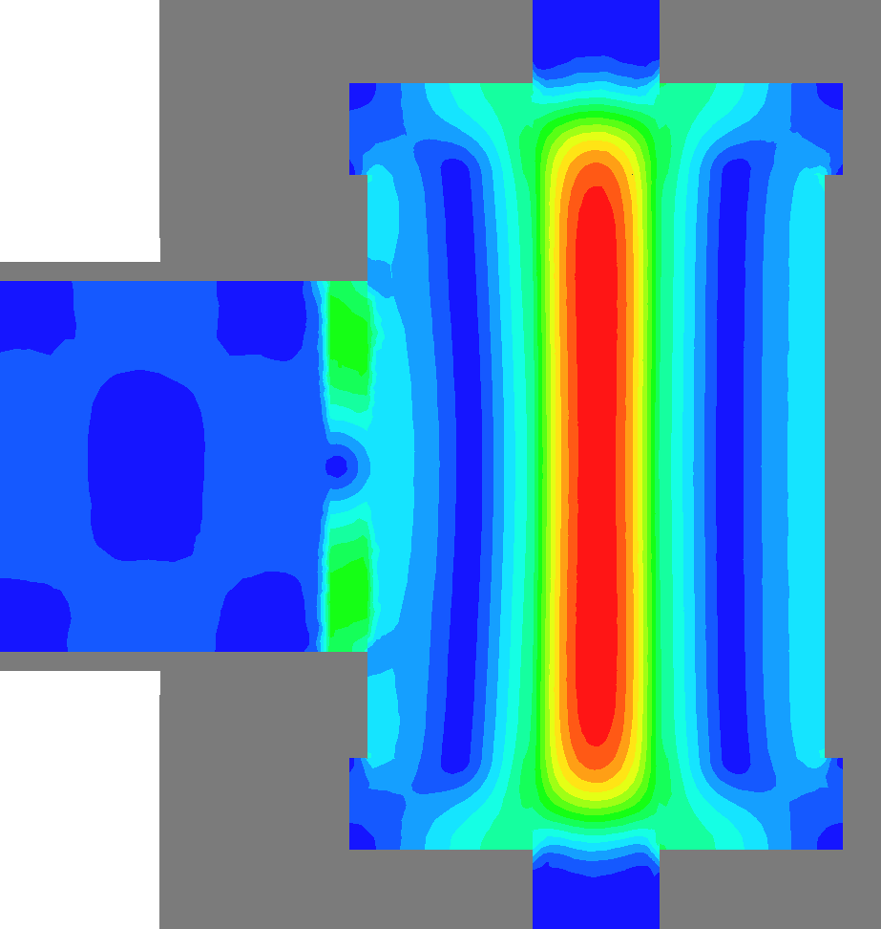
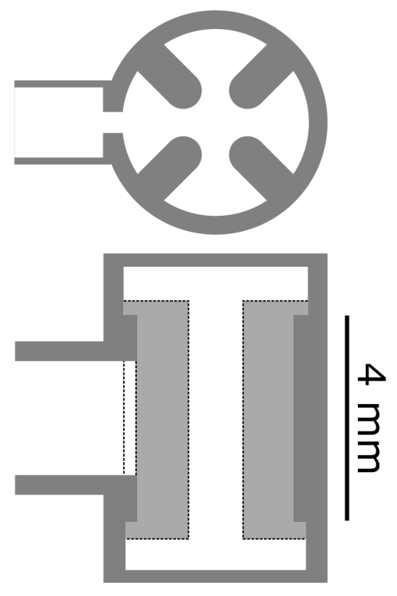
Extension to W-band
Geometry | Cylindrical TE₀₁₁ D/L=1 | UF TE_{01U} Re-Entrant
Frequency | 95.3 | 95.0
Q₀-value | 7500 | 4880
Signal, S_{u} | 578 | 854
Signal, S_{s} | 34.7 | 49.9
C_{max} [mT/W^{1/2}] | 1.66 | 1.71
C_{ave} [mT/W^{1/2}] | 0.81 | 1.52
% Diff | 51.2 | 11.1
Sample Geo. | 0.7 ID x 0.87 OD | 0.5 ID x 0.87 OD

Slide 25




Acknowledgements
Prof. Dieter Suter
Dr. Nick Cox
Dr. Hideaki Ogata
Dr. Edward Reijerse
Prof. Wolfgang Lubitz
Marie Skłodowska-Curie Individual Fellowship
http://act-epr.org
Notes:
----- Meeting Notes (3/30/17 16:36) -----
it is very difficult to figure out the F-clusters, g tensors axis were located in NiFe and help develop the calculations also g tensor axis for DFT!!
no real finalized DFT and g-tensor interactions
need g-tensor axis system for EDNMR/ENDOR
case study example
extremely limited introduction slide
in general, biological systems are of low symmetry so crystal structures don't give g-tensor info
in single crystals you can measure the g/A at room temp, and no averaging out the tensors
spings/G/s W-band 10^(7or8)
how improtant the structural axis interaction is, low symmetry high complex system
----- Meeting Notes (3/30/17 16:58) -----
mention Blanck PMR resonators
g strain higher at high frequency.
Q-band with Blank is in the works

Slide 26
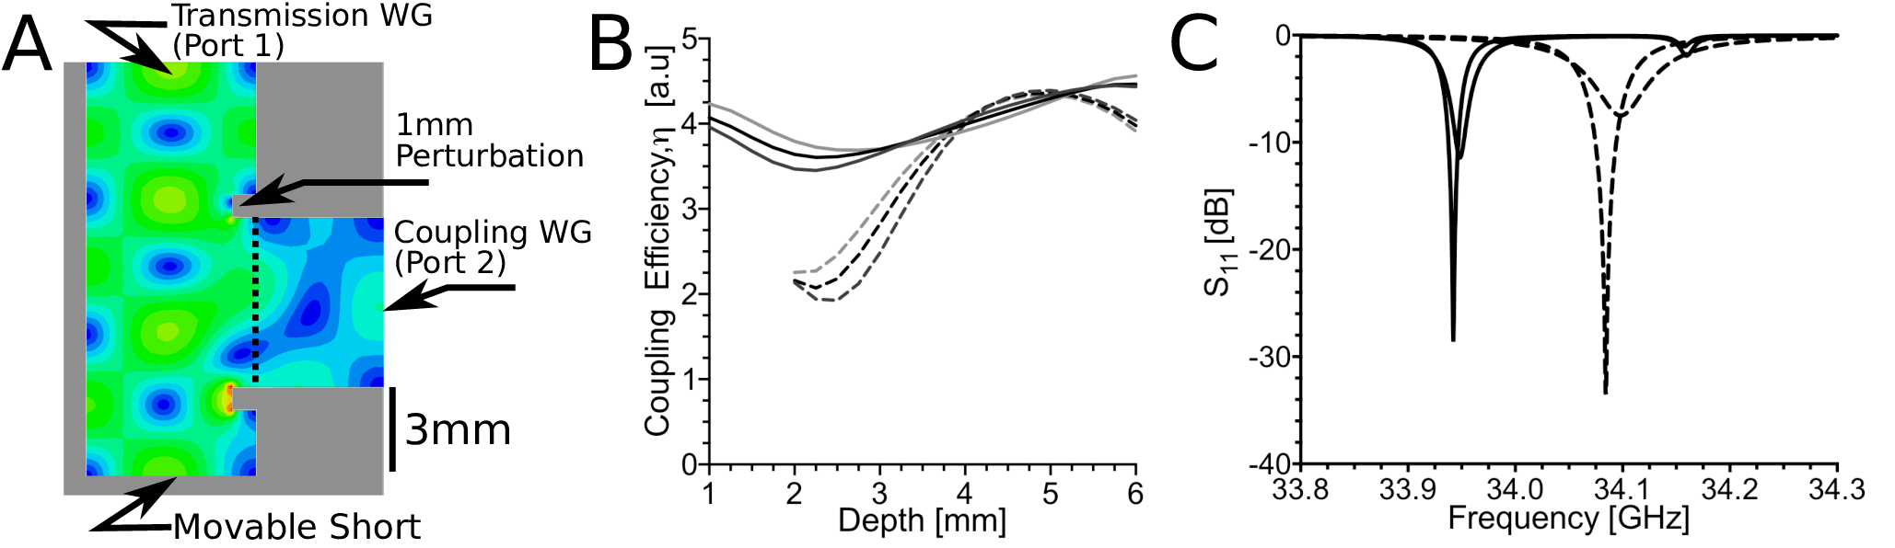
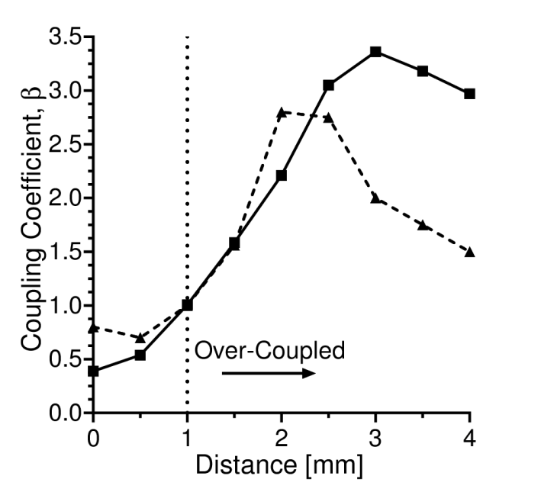

Slide 27
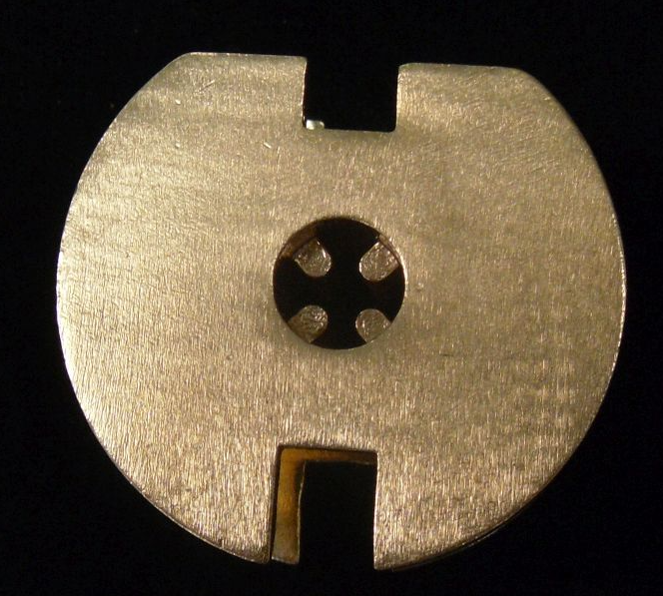
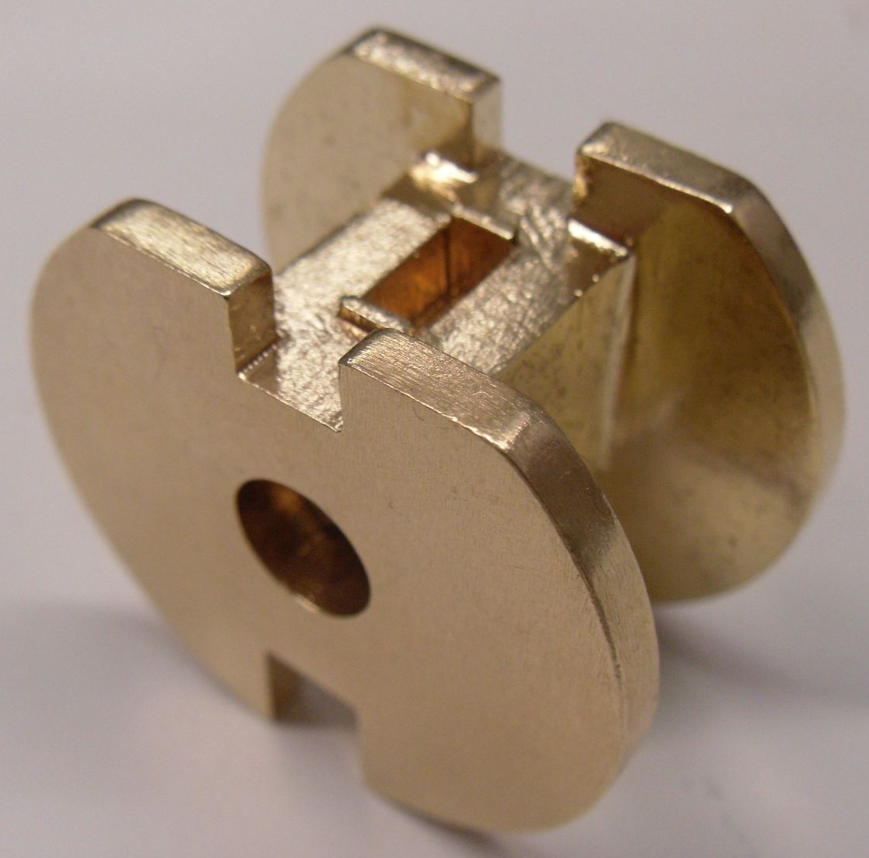
3D Printed Resonators at Q-band
Current 3D printing technology may be good enough for Q-band tolerances
Solid brass or silver is available using molding techniques
Higher precision techniques exist for ABS plastics that can be plated.

